Slide 1

Basic details of the Team and Problem Statement
Ministry/Organization Name/Student Innovation: Ministry of Micro, Small and Medium Enterprises.
PS Code: SIH1400
Problem Statement Title: Uncontrolled Growth of Water Hyacinth in Lakes.
Team Name: Biotech1
Team Leader Name: Ayush Das
Institute Code (AISHE):
Institute Name: Institute of Engineering and Technology, Maharshi Dayanand University, Rohtak
Theme: Agriculture, Foodtech and rural Development

Slide 2
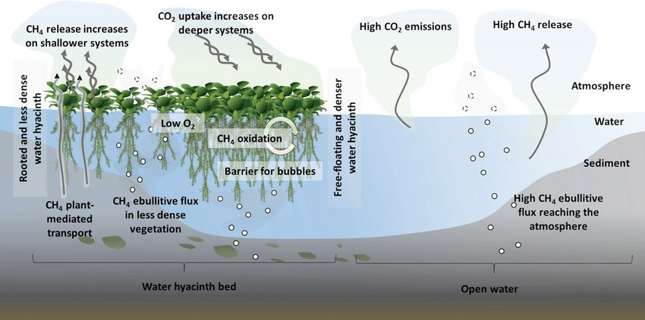
Idea/ Approach Details:
TECHNOLOGY STACK:
Artificial Intelligence: artificial neural network
Abstract window toolkit: data processing and graphical images
Bio Enable Sensing: measuring dissolved oxygen, nutrients, ph.
Drone Sensing: high resolution optical images.
i
IDEA/ SOLUTIONS:
Biomanipulation of water hyacinth using tilapia is a sustainable approach for uncontrolled growth of invasive weed as:
Environmentally Friendly: it doesn't involve the use of chemical herbicides or mechanical removal, which can have negative environmental impacts.
Herbivorous Feeding Behavior: Tilapia are primarily herbivores and readily consume water hyacinth, without being a predator on any other species.
Sustainable: Tilapia can reproduce quickly just like water hyacinth.
.

Slide 3
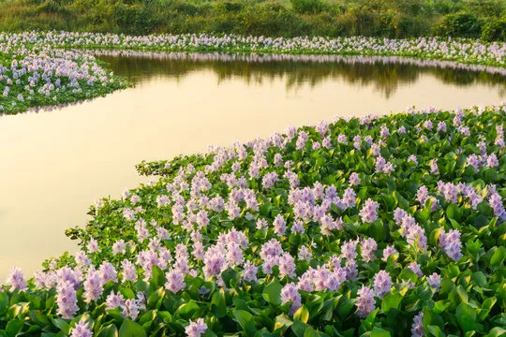

USED ONE’S:
BIOLOGICAL METHOD: Neochetina beetle are used in various country but they cant survive in India as they only work for clean water bodies
FUNGAL CONTROL: Aspergillus Niger and Trichoderma Spp. fungi were synergistically promising to minimize water hyacinth expansion at above 26°C and at less than 25% humidity.
HERBICIDAL CONTROL: widespread of nonessential toxic heavy metal can be hazardous.
Show stopper:
“Tilapia, a herbivorous , edible, sustainable, adaptable, eco friendly fish is the ultimate solution”
Business idea:
BIODEGRADABLE SANITARY NAPKINS: includes collecting, cleaning, cutting and sterilizing of water hyacinth stalks.
HANDICRAFTS: dried stem of water hyacinth are processed to make different products like mats, baskets, fruit trays, bottle holders, wall hangings, jewelry box, table mats, bags etc.

Slide 4
Team Member Details
Team Leader Name: Ayush Das
Branch: B.Tech Stream: Biotechnology Year: IV
Team Member 1 Name: Khushi
Branch: B.Tech Stream: Biotechnology Year: II
Team Member 2 Name: Riya
Branch: B.Tech Stream: Biotechnology Year: III
Team Member 3 Name: Harsh
Branch: B.Tech Stream: Biotechnology Year: IV
Team Member 4 Name: Sahil
Branch: B.Tech Stream: Mechanical Year: II
Team Member 5 Name: Tannu
Branch: B.Tech Stream: Biotechnology Year: IV
Team Mentor 1 Name: Manvinder Gahlaut
Category: Academic Expertise: Environmental pollution Domain Experience: 15 years
Team Mentor 2 Name: Veer Bhan
Category: Academic Expertise: Genetics: Domain Experience: 20 years

